Slide 1

CAREER GUIDANCE
SEMINAR

Slide 2
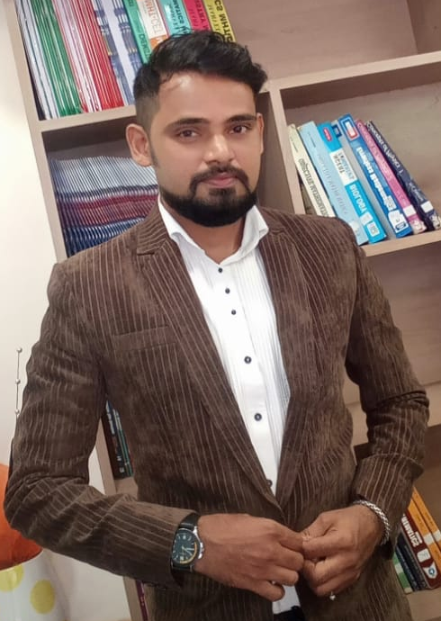
Mr. JIGNESH HINGU
Senior Executive
N K Academy
B.E (Electronics)
Vivekanand Education Institute Of Technology

Slide 3

WHAT IS A CAREER???

Slide 4
CAREER IS
THE WORK WHICH YOU LOVE.
WORK WHICH YOU CAN DO ALL DAY LONG WITHOUT GETTING BORED OR TIRED.
EVEN IF YOU NOT GET PAID FOR TWO YEARS YOU WILL ALL LOVE TO PURSUE THAT FIELD.
THE WORK FOR WHICH YOU WANT TO BE KNOWN FOR.

Slide 5
WHY TO SELECT A PEREFECT CAREER
WORK FOR AT LEAST 10 HOURS A DAY
AND IF WE SAY 6 DAYS A WEEK MEANS YOU HAVE TO WORK FOR 60 HOURS IN A WEEK .
LIKE WISE WE CAN SAY 3000 HOURS IN A YEAR.
AND IF WE WORK FOR 30 YEARS OF OUR LIFE THAN YOU HAVE TO SPEND 90000 HOURS OF YOUR LIFE .
SO LET’S DECIDE WHAT YOU WANT TO DO.

Slide 6

LIFE IS A JOURNEY …
SOME ENJOY IT .
SOME SPEND IT …….

Slide 7
What after 10th
Science
Commerce
Arts
To decide which stream to select, we must have an idea about stream subjects. Then as per our interest in subjects we can proceed with stream selection.
Lets have a look at subject in each stream.

Slide 8
What after 10th
Science
Commerce
Arts
Physics
Maths
Maths
Chemistry
Accounts
Eco
Maths
Eco
History
Biology
OC
Geography
Hindi
Hindi
Hindi
English
English
English

Slide 9
Career options in Science
Science
P/C/M/B/H/E
General Science
Board Test Sub
P/C/M/PSY/IT/E
Bifocal Science
600 Marks Exam
P/C/M/CS/E
Bifocal Science
Technical
Medical
Engg
Doctor
Pharma
Para
BSC
Arch
Def
Marine
Aviation
Space
JEE
(Mains/ Adv)
JEE 2
NDA
IMU-CET
ENGG
ENGG
NEET
MHT-CET
BSC
MHT-CET
NATA
PCM Based Test
PCB Based Test

Slide 10
Engineering
National Level College
State Level College
IIT – JEE ADV
VJTI
NIT – JEE Mains
VESIT
IIIT – JEE Mains
COEP- Pune
BITS - BITSAT
S.P
D J Sanghavi
Thadomal
Father Ag.
K J Somaiya
Francis
Thakur
For all Maharashtra colleges MHT-CET

Slide 11
JEE – Joint Entrance Exam
20 - MCQ
P
C
M
25
25
25
75 Questions
10 – Num (Any 5)
60 min
60 min
60 min
180 Minutes
(+4, -1)
Marking
100 Mrk
100 Mrk
300 Marks
100 Mrk
17 – 20 Lacs students appearing per year
Qualifying criteria : 90+ Marks
Approx. 2.4 Lac students qualifying each year
NCERT Portion

Slide 12
MHT- CET : Maharashtra Common Entrance Test for Engg
P
C
M
50
50
50
150 MCQ
1 Mrk
1 Mrk
2 Mrk
Per Q
No –Ve Marking
50 Mrk
50 Mrk
200 Total Marks
100 Mrk
150+ required to get in to top 5 institute
Maharashtra State Board Portion

Slide 13
MHT- CET : Maharashtra Common Entrance Test for Pharma
P
C
B
50
50
100
200 MCQ
1 Mrk
1 Mrk
1 Mrk
Per Q
No –Ve Marking
50 Mrk
50 Mrk
200 Total Marks
100 Mrk
150+ required to get in to top 5 institute
Maharashtra State Board Portion

Slide 14
NEET : National Eligibility Entrance Test
P
C
B
45
45
90
180 MCQs
60 min
60 min
60 min
180 Minutes
(+4, -1)
Marking
180 Mrk
180 Mrk
720 Total Marks
360 Mrk
17 – 20 Lacs students appearing per year
1.4 Lac students get in to MBBS
600+ required to get in to MBBS
NCERT Portion

Slide 15
BSC
MHT-CET
NEET
Bachelor in ARCH
NATA
VJTI/SPC/DJSCOE
MHT-CET
NIT/BITS/IIIT
JEE MAIN BITSAT
IIT
JEE ADVANCE
12th Science
MEDICAL
B.PHARM
M.PHARM
Physics
Chemistry
Maths
Biology
Astronomy
Forensic Science
Geology
Agriculture
IT
Statistics
Fashion Technology
Home Science
Nutrition
Nautical Science
Genetics
Computer Science
Information Technology
Mechanical Engineering
Chemical Engineering
Civil Engineering
Electrical Engineering
Automobile Engineering
Mechatronics
Biomedical Engineering
.
Diploma in Interior Designing
Diploma in Landscape Designing
Masters in A rchitecture
M.B.B.S (Bachelor of Medicine and Bachelor of SUURGERY
B.D.S ( Bachelor of Dental Surgery )
B.A.M.S (Bachelor of Ayurveda Medicine & Surgery)
B.H.M.S (Bachelor of Hom Medicine & Surgery)
B.U.M.S (Bachelor in of Unani Medicine & Surgery)
B. V. SC ( Bachelor in Veterinary in Science

Slide 16
SPACE SCIENCE
. B . TECH in Marine Engineering
.BSC in Nautical SCIENCE
.Naval Architecture & Ocean Engineering
IMU-CET
PARAMEDICAL
OTHER CAREER OPTIONS
NDA
. ATC
. Commercial Pilot
. Aircraft Maintenance Engineering
. Aeronautical Engineering
AVIATION
. Medical Technology
. Physical Therapy(BPT)
. Ophthalmic Technology
. Laboratory Technology
. Psychology Dermatology
. physical Therapy
. Audiology Therapy
. Speech Language & Hearing
. Cosmetology
. Radio Therapy ( BPT )
.Mental Rehabilitation
INDIAN ARMY
INDIAN NAVY
INDIAN AIR FORCE
. NASA
. IIST - ISRO

Slide 17
IITs,
There are currently 23 Indian Institutes of Technology (IITs) in India. Here is a list of all the IITs, along with the year they were established:
IIT Kharagpur - 1951
IIT Bombay - 1958
IIT Madras - 1959
IIT Kanpur - 1959
IIT Delhi - 1961
IIT Guwahati - 1994
IIT Roorkee - 2001 (earlier University of Roorkee, established in 1847)
IIT Hyderabad - 2008
IIT Gandhinagar - 2008
IIT Patna - 2008
IIT Bhubaneswar - 2008
IIT Ropar - 2008
IIT Indore - 2009
IIT Mandi - 2009
IIT Jodhpur - 2009
IIT Varanasi (BHU) - 2012 (earlier IT-BHU, established in 1919)
IIT Palakkad - 2015
IIT Tirupati - 2015
IIT Dhanbad (ISM) - 2016 (earlier Indian School of Mines, established in 1926)
IIT Bhilai - 2016
IIT Goa - 2016
IIT Jammu - 2016
IIT Dharwad - 2016
All of these institutions are recognized as premier engineering institutes in India and are highly sought after by students aspiring to pursue engineering as a career

Slide 18
Best engineering colleges in Mumbai:
Mumbai, also known as the financial capital of India, is home to several top engineering colleges. Here is a list of some of the best engineering colleges in Mumbai:
Indian Institute of Technology Bombay (IIT Bombay)
Veermata Jijabai Technological Institute (VJTI)
Sardar Patel College of Engineering (SPCE)
Dwarkadas J. Sanghvi College of Engineering (DJSCOE)
Thadomal Shahani Engineering College (TSEC)
K. J. Somaiya College of Engineering (KJSCE)
Fr. Conceicao Rodrigues College of Engineering (CRCE)
Mukesh Patel School of Technology Management and Engineering (MPSTME)
Narsee Monjee Institute of Management Studies (NMIMS)
Rizvi College of Engineering (RCOE)
These colleges offer undergraduate and postgraduate programs in various fields of engineering, such as computer science, mechanical engineering, electrical engineering, civil engineering, and more. They have state-of-the-art infrastructure, experienced faculty, and a strong industry connect, making them highly sought after by students aspiring to pursue engineering as a career.

Slide 19
Best medical colleges in India:
India is home to several top-ranked medical colleges that offer undergraduate and postgraduate courses in medicine and related fields. Here are some of the best medical colleges in India:
All India Institute of Medical Sciences (AIIMS), New Delhi
Christian Medical College (CMC), Vellore
Armed Forces Medical College (AFMC), Pune
Maulana Azad Medical College (MAMC), New Delhi
Jawaharlal Institute of Postgraduate Medical Education and Research (JIPMER), Puducherry
King George's Medical University (KGMU), Lucknow
Grant Medical College and Sir JJ Group of Hospitals, Mumbai
Institute of Medical Sciences (IMS), Banaras Hindu University, Varanasi
Kasturba Medical College (KMC), Manipal
Madras Medical College (MMC), Chennai
These medical colleges have world-class infrastructure, experienced faculty, and offer excellent academic and research opportunities to students. They also have a strong alumni network and industry connect, making them highly sought after by students aspiring to pursue a career in medicine.

Slide 20
Top medical colleges in Mumbai:
Mumbai is home to several reputed medical colleges that offer undergraduate and postgraduate courses in medicine and related fields. Here are some of the top medical colleges in Mumbai:
Grant Medical College and Sir JJ Group of Hospitals
Topiwala National Medical College (TNMC)
Seth Gordhandas Sunderdas Medical College (GSMC)
Lokmanya Tilak Municipal Medical College (LTMMC)
K. J. Somaiya Medical College and Research Centre
Tata Memorial Centre (TMC)
Nair Hospital Dental College
Bharati Vidyapeeth Deemed University Medical College and Hospital
Dr. D.Y. Patil Medical College and Hospital
Padmashree Dr. D.Y. Patil Medical College, Navi Mumbai
These medical colleges have well-equipped facilities, experienced faculty, and offer excellent academic and research opportunities to students. They also have a strong industry connect and collaborations with top healthcare institutions, providing students with exposure to real-world medical practices.

Slide 21
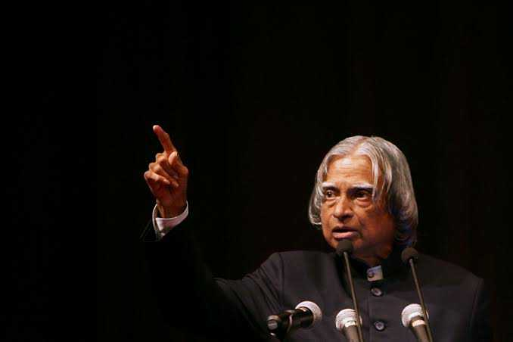
DR. A.P.J. ABDUL KALAM SIR (INDIAN MISSILE MAN)
MIT in 1960
In 1963 to 1964, he visited NASA's Langley Research Center in Hampton, Virginia
Aerospace engineer
“IF YOU WANT TO SHINE LIKE SUN, THEN BURN LIKE THE SUN”

Slide 22
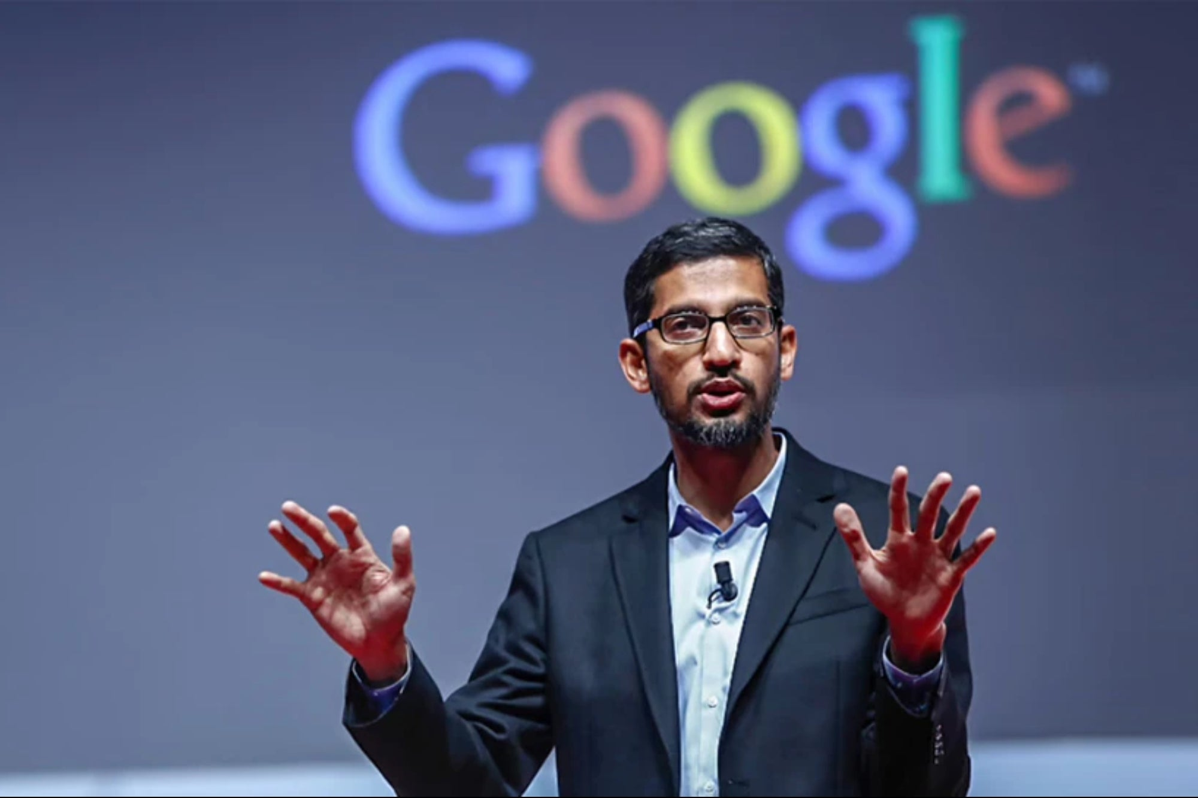
(CEO :- GOOGLE) SUNADR PICHAI
Education:
IIT Kharagpur
(‎B.Tech‎) ‎
Title:
CEO of Alphabet‎ and ‎Google‎
INCOME:
Rs 1880 crore

Slide 23
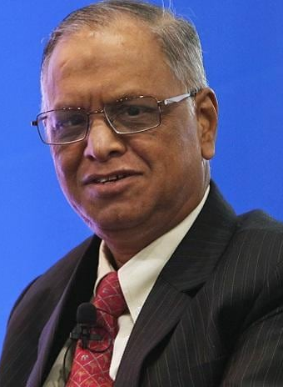
N.R. NARAYAN MURTHI
Graduated from the NIUM
Bachelor's degree in electrical engineering
Master's degree from the Indian Institute of Technology Kanpur.
Net worth: $4.5 billion
And gains many national and international awards

Slide 24

Founders of Snapdeal
Net worth : ₹510 crore (US$64 million)
Kunal bhal
Education, B.S.E in Entrepreneurship, Operation & IM, Wharton B.A.S in Engineering.
Rohit Bansal
Education: IIT Delhi, Delhi Public School R.K.Puram, Delhi Public School Society

Slide 25
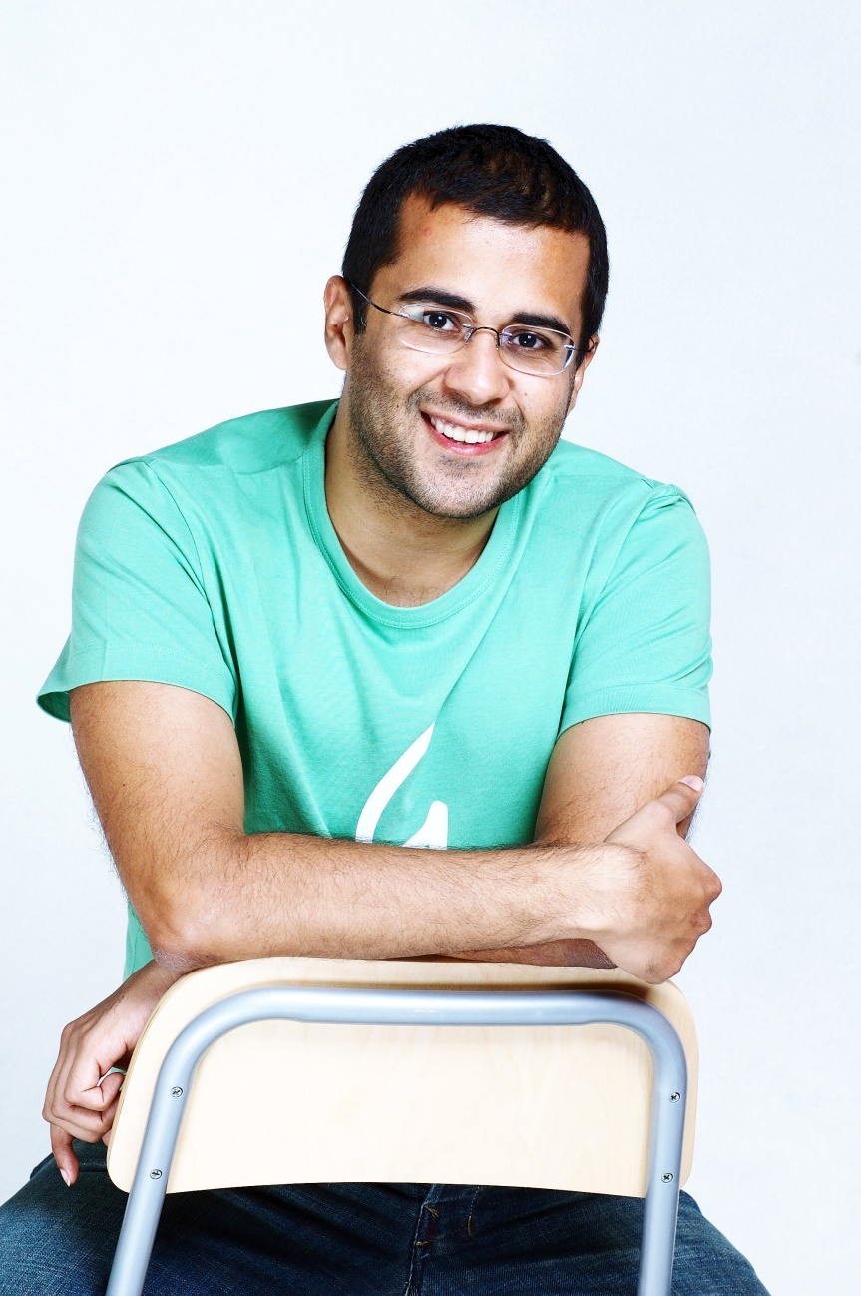
CHETAN BHAGAT
Mechanical engineering from IIT Delhi
PGP from IIM Ahmedabad.
Net worth : 208 cr,

Slide 26

DEEPINDER GOYAL
Net worth : Rs. 2,392.3 Cr
Founder & CEO,
IIT Delhi

Slide 27
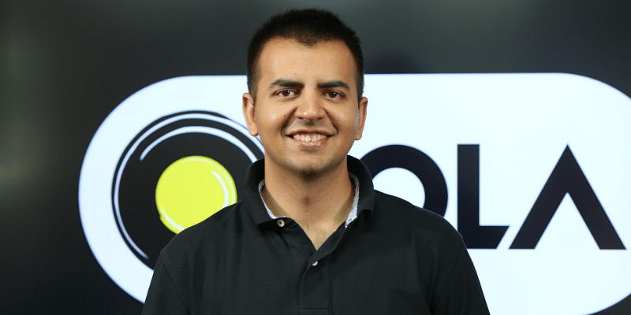
BHAVISH AGGARWAL
bachelor's degree in computer science
engineering at IIT MUMBAI in 2008
CEO of OLA cab.
wealth: 11,700 crore

Slide 28
CAREER CAN BE IN ANYTHIG!!!!
BIOLOGIST DOCTOR ENGINEERING ENTERPRENEURSHIP COMPUTER SCIENCE ZOOLOGY EVENT MANAGER CHARTERED ACCOUNTANT MASTERS IN BUSINESS ETHICS ACTING DANCING SINGING SPORTS FOOD INDUSTRY
OWN STARTSUP TRADING SALON OPENING A STORE BEAUTY PARLOUR
PUBLIC SPEAKING MEDICAL

Slide 29
WHAT MAJORITY SELECT
BASED ON THEIR FRIENDS CHOICE
BASED ON THEIR PARENTS LIKING
BASED ON THEIR RELATIVES ADVICE
LACK OF UNDERSTANDING OF ALL FIELDS

Slide 30
PARAMETERS FOR CHOOSING A CAREER
APTITUDE IN THAT FIELD
PERSONAL INTERESTS
CAREER PROSPECTS AND GROWTH IN THE FIELD

Slide 31

WHAT AFTER 10TH

Slide 32

LETS SOLVE THE CONFUSION STEP BY STEP

Slide 33
11TH , 12TH
SCIENCE
COMMERCE
ARTS

Slide 34

SCIENCE

Slide 35
THE MAJOR SUBJECTS
PHYSICS
CHEMESTRY
BIOLOGY
ENGLISH
MATHEMATICS
HINDI
ENGLISH

Slide 36
ENGINEERING
11TH
12TH
MHT – CET (PCM)
BE 4 YEARS COURSE
ADMISSION WILL BE BASED ON MH – CET SCORE

Slide 37
FIELDS IN ENGINEERING
COMPUTER
IT
ELECTRONICS
INSTRUMENTATION
EXTC
BIOMEDICAL
MECHANICAL
METALLURGY
AUTOMOBILE
MARINE
AI
CIVIL
DATA SCIENCE
CHEMICAL
TEXTILE
PLASTIC
AERONAUTICAL
ELECTRICAL

Slide 38
ENGINEERING COLLEGES IN MUMBAI
VJTI
SP
DJ SANGHVI
KJSOMAIYA
VIVEKANANDA
THADOMAL
THAKUR
VIDYLANKAR
FR. AGNEL
ST. FRANCIS
ATHARVA
RGIT
NMIMS
VARTAK

Slide 39

IIT
11TH
12TH
(PCM) JEE MAINS
JEE ADVANCE
BE/BTECH 4 YEAR COURSE

Slide 40
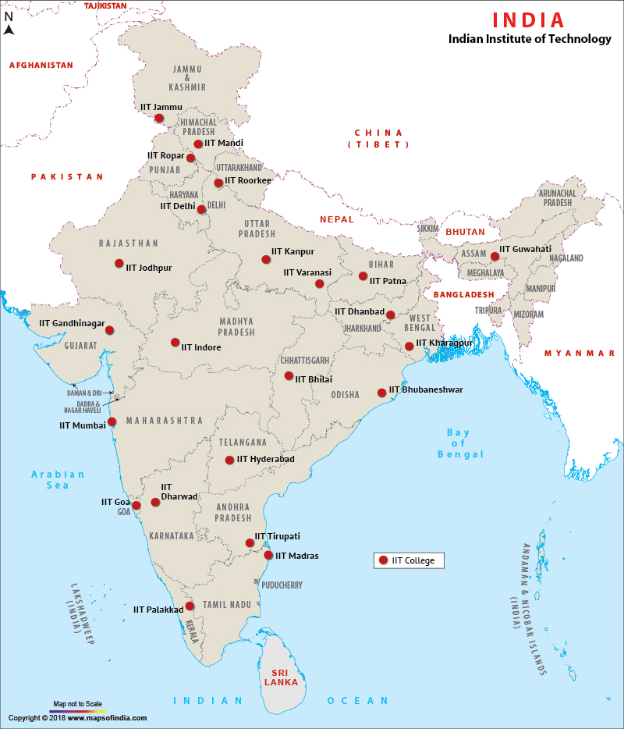
JEE ADVANCE
IIT’S

Slide 41

ARCHITECTURE – JEE 2/NATA
BACHELOR OF ARCHITECTURE
NATIONAL APTITUDE TEST IN ARCHITECTURE (NATA)
5 YEAR COURSE – CIVIL ENGINEERING + DESIGNING +CREATIVITY

Slide 42
TOP COLLEGES OF ARCHITECTURE
KAMALA RAHEJA VIDYANIDHI INSTITUTE FOR ARCHITECTURE
THAKUR COLLEGE OF ARCHITECTURE
RIZIVI COLLEGE OF ARCHITECTURE
IES COLLEGE OF ARCHITECTURE
SIR JJ COLLEGE OF ARCHITECTURE
VASANTDADA PATIL PRATISHTHAN’S MANOHAR PHALKE COLLEGE OF ARCHITECTURE
RACHANA SANSAD
NMIMS BALWANT SEATH SCHOOL OF ARCHITECTURE
HIRAY COLLEGE
L.S. RAHEJA SCHOOL OF ARCHITECTURE
AMITY SCHOOL OF ARCHITECTURE AND PLANNING
ASIAN SCHOOL OF ARCHITECTURE AND DESIGN INNOVATION
CHANDIGARH COLLEGE OF ARCHITECTURE
DR. BHANUBEN NANAVATI COLLEGE OF ARCHITECTURE FOR WOMEN
INSTITUTE OF ARCHITECTURE & PLANNING –NIRMA UNIVERSITY
MBS SCHOOL OF PLANNING AND ARCHITECTURE
PILOO MODY COLLEGE OF ARCHITECTURE
RIZIVI COLLEGE
RV COLLEGE OF ARCHITECTURE
SCHOOL OF ARCHITECTURE & DESIGN , JAIPUR
IN MUMBAI
IN INDIA

Slide 43
MEDICAL FIELD AFTER 12TH
12TH SCI – PCB – NEET – MBBS/ MD/ MS
12TH SCI – PCB – NEET – MBBS/ BDS/ BAMS/ BHMS/ BUMS/ B.V.SC/ B PHARMA/
D PHARMA/ NURSING/ NUTRITION SCIENCE

Slide 44

COURSE IN MEDICAL
GYNECOLOGY
SPEECH THERAPIST
OPTHALMOLOGY
PATHOLOGY
PHYSIOTHERAPIST
UROLOGY
PEDIATRICS
PLASTIC SURGERY
NEUROLOGY
DENTIST
SURGERY

Slide 45
TOP COLLEGES FOR MEDICAL
SETH GS MEDICAL COLLEGE
TOPIWALA NATIONAL MEDICAL COLLEGE
GRANT MEDICAL COLLEGE, J.J. HOSPITAL
D.Y. PATIL DENTAL COLLEGE
RA PODAR AYURVED MEDICAL COLLEGE
KEM
TERNA MEDICAL COLLEGE
NAIR HOSPITAL DENTAL COLLEGE
RAJIV GANDHI MEDICAL COLLEGE
MAHATAMA GANDHI MEDICAL COLLEGE
K.J. SOMAIYA MEDICAL COLLEGE

Slide 46
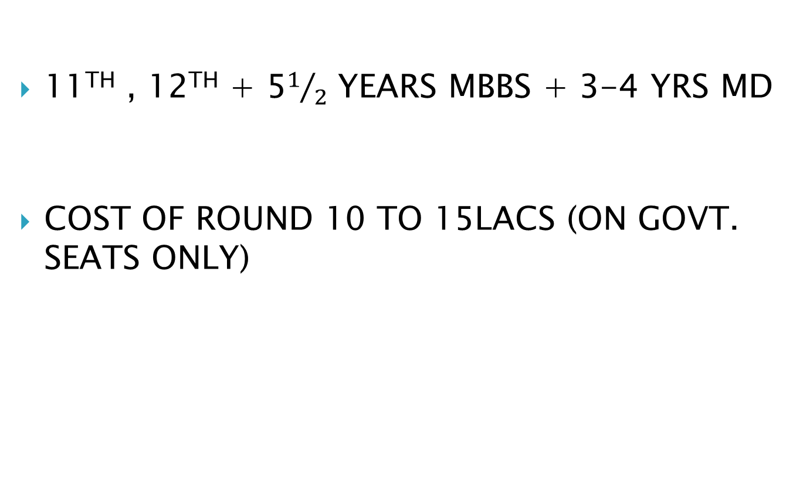
COST AND TIME SPAN
11TH , 12TH + 5$1/2$ YEARS MBBS + 3-4 YRS MD
COST OF ROUND 10 TO 15LACS (ON GOVT. SEATS ONLY)

Slide 47
12TH SCIENCE - BSC
PHYSICS
CHEMESTRY
MATHEMATICS
BSC
IT
ASTROPHYSICS
NUCLEAR PHYSICS
INDUSTRIAL CHEMESTRY
FORENSIC SCIENCES
STATISTICS
ANIMATION

Slide 48
12TH SCI – PCB - BSC
MICROBIOLOGY
FORENSIC SCIENCE
ZOOLOGY
INDUSTRY CHEMISTRY
CHEMESTRY
GENETICS
FOOD TECHNOLOGY
FORESTRY
AGRICULTURE
BIOLOGIST
BEAUTY THERAPY
MEDICAL LAB TECH
MEDIA
NURSING
COMMUNICATION
BOTANY
BIOTECHNOLOGY
CATERING

Slide 49
SCOPE AFTER BSC ,BE, BTECH
JOB
IAS,IPS,IES,CDSE,UPSE,MPSE
CAT/ CMAT/ NMAT/ SNAP/ XAT FOR MBA
GMAT FOR MBA IN US, CANADA, EUROPE
GRE/ TOEFL FOR MS IN FOREIGN COUNTRIES
GATE FOR M. TECH IN IIT
ME AND MTECH FOR TEACHING CAREER

Slide 50

COMMERCE

Slide 51
COMMERCE
THE MAJOR SBJECTS THAT ARE COVERED UNDER THE COMMERCE STEAM ARE:
ACCOUNTANCY
SP (SECRETIAL PRACTICE)
ORGNIZATION OF CMMERCE
ECONOMICS
MATHEMATICS
HINDI
ENGLISH

Slide 52

COMMERCE
BCOM + ANY MAJOR COURSE ALONG WITH IT.

Slide 53
HSC COMMERCE
TRADITIONAL COURSES
B COM (3 YEARS)
C.A. (5 YEARS)
C.S. (4 YEARS)
I.C.W.A. (3 YEARS)( INSTITUTE OF COST & WORKS ACCOUNTS)
L.L.B. (5 YEARS)(LEGISLETIVE LAW BACHELOR)

Slide 54
HSC- COMMERCE
B.M.S. (3 YEARS) (BACHELORS OF MANAGEMENT STUDIES)
B.A.F. (3 YEARS) (BACHELOR OF ACCOUNTING & FINANCE)
B.B.I. (3 YEARS) (BECHOLAR OF BANKING AND INSURANCE)
B.M.M. (3 YEARS) (BECHOLAR OF MASS MEDIA)(JOURNALISM, ADVERTISING, MASS COMMUNICATION, COPYWRITTING)
B.F.M. (3 YEARS) (BECHOLAR OF FINE ARTS)
B.B.A. (3 YEARS) (BECHOLAR OF BUSINESS ADMINISTRATION)
B.C.A (3 YEARS) (BECHOLAR OF COMPUTER APPLICATION)

Slide 55
HSC COMMERCE
POST GRADUATE COURSES
M.COM (2 YEARS)
M.B.A. (2 YEARS)
M.C.A. (3 YEARS)
C.F.A. (3 YEARS)
OTHER DIPLOMA COURSES
D.B.M. (1 YEAR)(DIPLOMA IN BUSINESS MANAGEMENT)
B.F.M. (1 YEAR)(BECHOLAR OF FINANCIAL MARKETS)
D.H.R. (1 YEAR)(DIPLOMA IN HUMAN RIGHTS)
EXIM (1 YEAR)(DIPLOMA IN IMPORT EXPORT)
C.F.P. (1 YEAR)(CERIFICATION FINANCIAL PLANNER)
C.P.A. (2 YEARS)(CERTIFICATE PUBLIC ACCOUNTANT)
MANY OTHER COURSES RUN BY EDUCATIONAL INSTITUTES

Slide 56
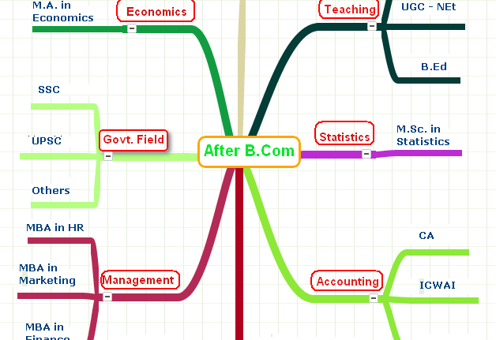

Slide 57
AFTER B.COM
JOB IN ACCOUNTING AND BANKING
B.ED – M.ED(BECHOLAR/ MASTER OF EDUCATION)
M.COM
CAT/ CMAT/ NMAT/ ZAT/ SNAP FOR MBA
MPSC, UPSC
MCOM – SET/NET (STATE ELIGIBILITY TEST FOR THE POST OF PROFESSORS IN UNIVERSITY)
BUSINESS

Slide 58
CONTACT US ON FOR ANY DOUBTS
CALL : Nandkishor Sir
8879511601
email: nand_nirukti@yahoo.com

Slide 59

WISH YOU ALL THE BEST FOR YOUR EXAMS.
WE ALL SURE THAT YOU WILL COME OUT WITH FLYING COLORS AND DO YOUR
SCHOOL , TEACHERS AND PARENTS
PROUD

